Slide 1

Besser 2 Startup Procedure
7.3.2024 version 1.0

Slide 2
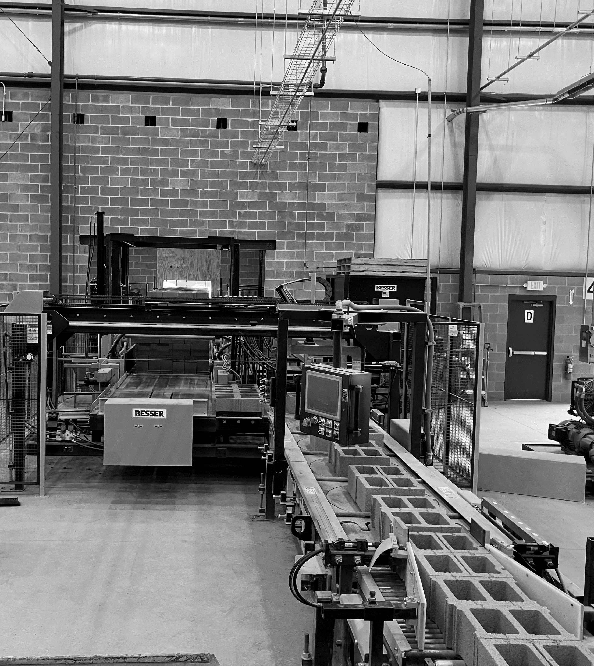
Assumptions and Prerequisite Skills
The hydraulic pumps are turned on.
Supplies Needed
Standard PPE

Slide 3
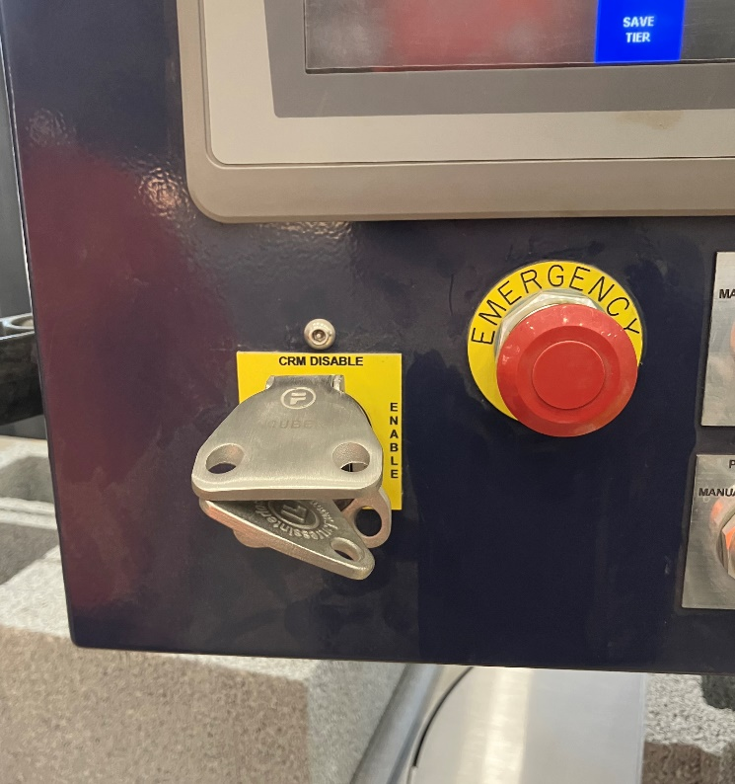
Key in CRM key on the cuber control panel and turn clockwise a quarter turn to “Enable” (Figure 1). This safety feature allows the machine to be turned on.
Figure 1

Slide 4
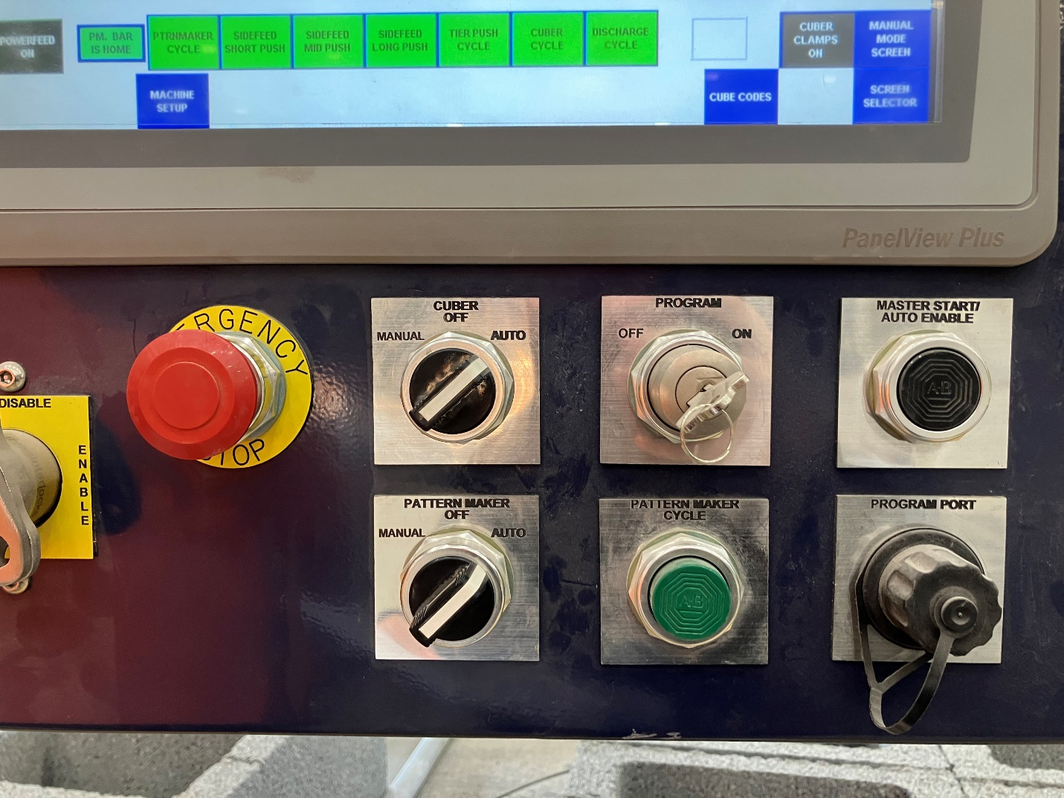
2. At the cuber control panel, pull out the “Emergency Stop” button and push “Master Start/Auto Enable” to start up the hydraulic pumps (Figure 2, Yellow arrow).
3. At cuber control panel, turn “Cuber” switch to Auto. Then turn the “Pattern Maker” switch to Auto. Make sure the “Program” key is turned on (Figure 2).
Figure 2

Slide 5
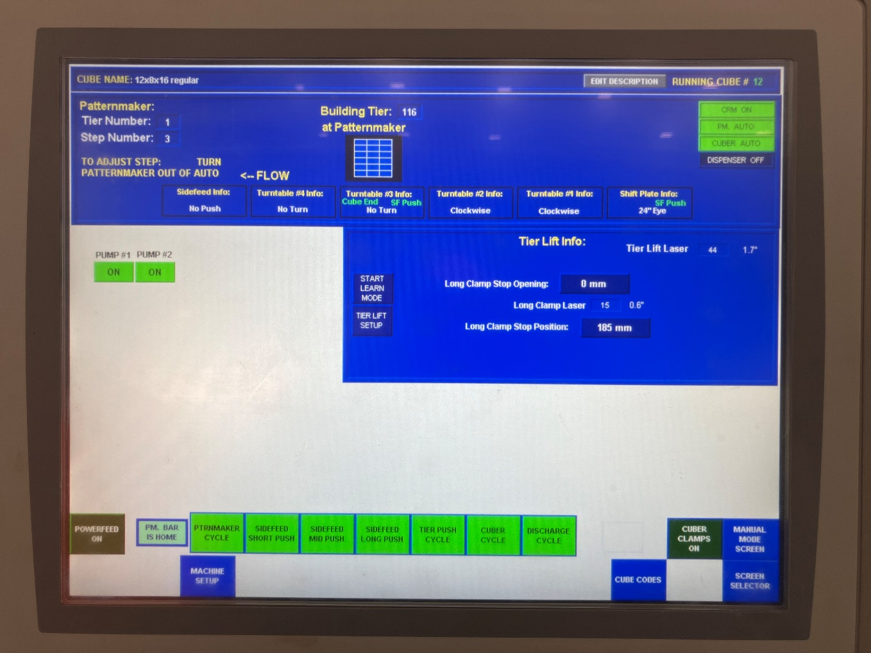
4. On the screen, go to “Screen Selector” in the bottom right corner of the screen (Figure 3) and then click “Product Report” (Next slide, figure 4). Make sure the “Resettable Cube Counter” is set to 0. Press “Run Screen” in the bottom left corner to go back to the home screen (next slide, figure 5).
Figure 3

Slide 6
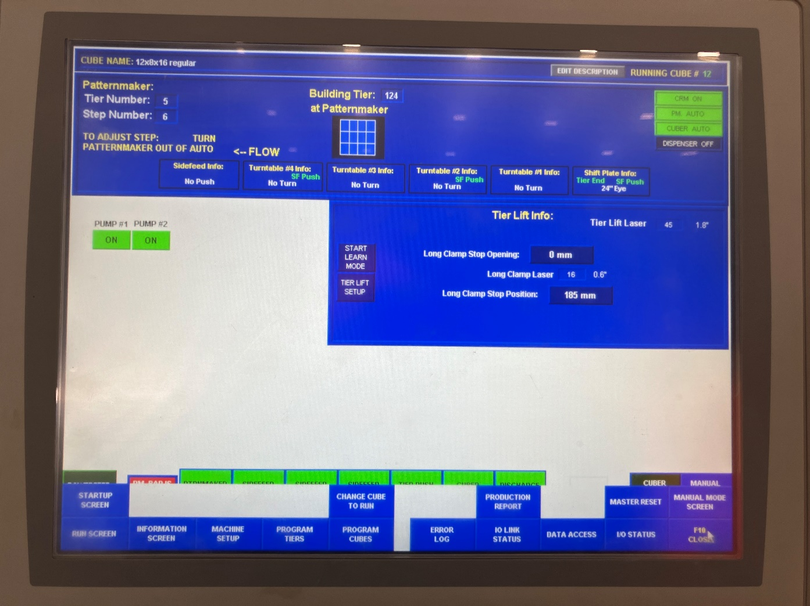
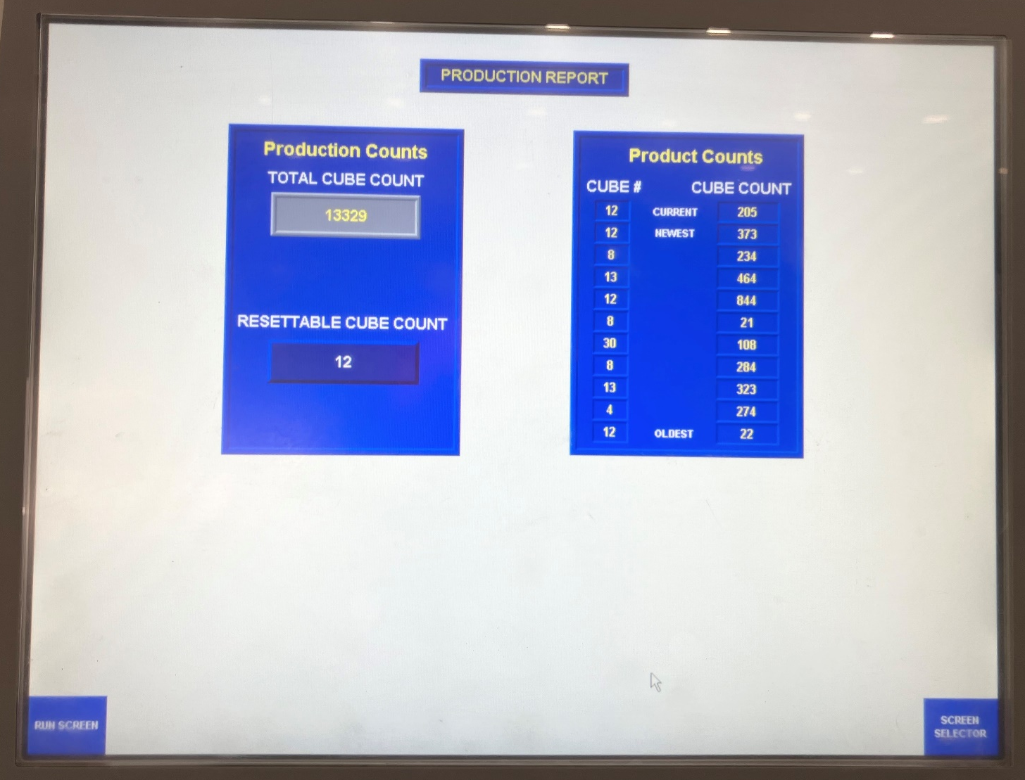
Figure 4
Figure 5

Slide 7
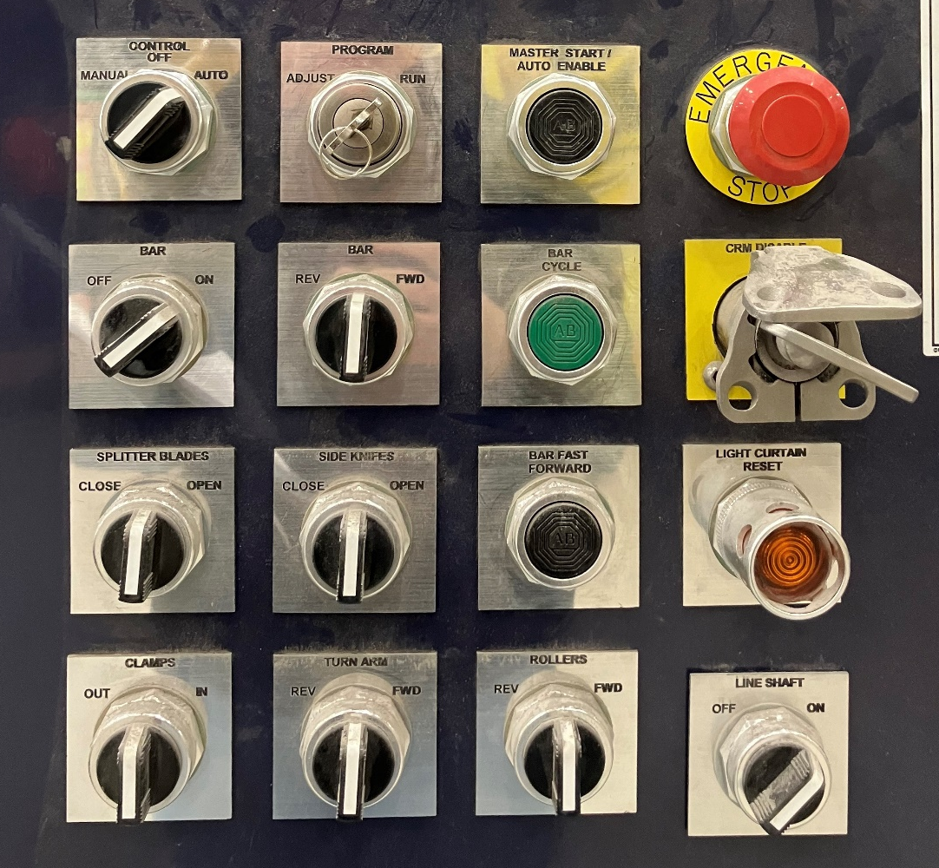
5. Walk over to the Splitter/Turn-over panel. If “Light Curtain” button is lit up, push it in to reset. (Figure 6, yellow arrow). It should no longer be lit up.
6. On the screen, verify that the “Step Count Powerfeed” is on. Turn control to Auto, and then push the “Master Start/Auto Enable” button. (Figure 6).
Figure 6

Slide 8
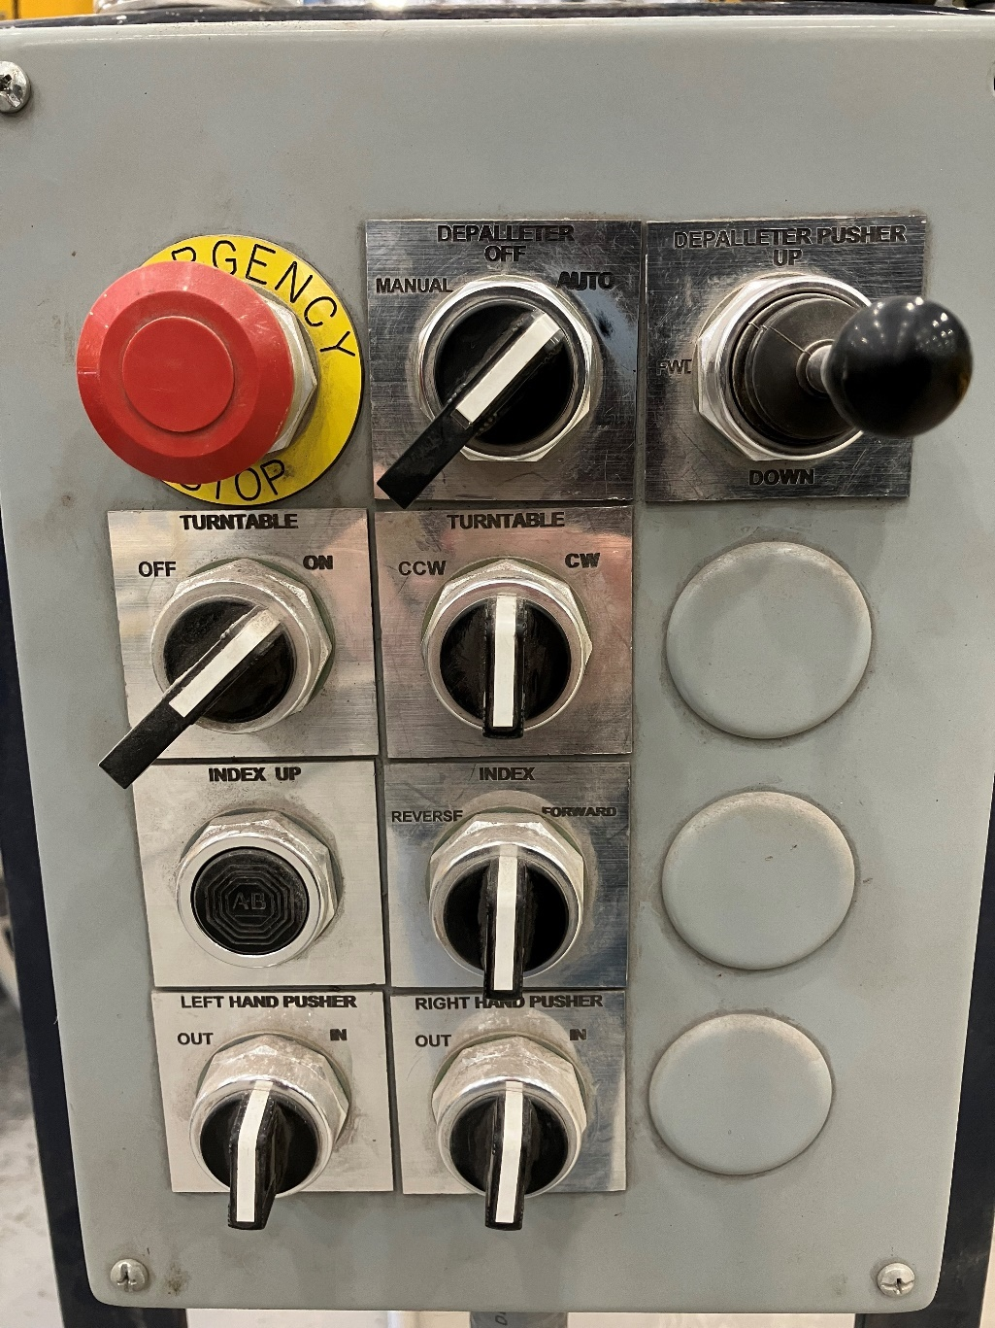
7. Next go to Depalleter Panel. Turn Depalleter to Auto (Figure 7).
This completes the startup procedure.
Figure 7

